Slide 1
PLT: Week 3
Week 2 Reminder
Post Production Systems
More general expression-generation schemas in Maths and English

Slide 2
Week 2 Review
The standard, unambiguous, pricise language of Maths;
Complex Expressions;
Their communication:
  Explicit ordering notations;
  2-D notations;
  Conventions;
  FPN, RPN.
Generating mathematical truisms from mathematical truisms:
  Proofs
  Post Production Systems
Notes:
Stretchable operators, brackets, overbraces
Conventions: associativity, priority
<νυμβερ>

Slide 3
Production systems for:
Unary, even numbers:
  11
  11111111
Unary odd numbers
  111
  111111111
  Specify the PP System
  Create the language instance:
    111111111
Notes:
When you get them, test them out with the generation of:
11111+111111111=11111111111111 (5 + 9 = 14)
11111*111=111111111111111 (5*3=15)
((( )( )))( )
And I want this correctly specified in the terminology I gave you

Slide 4
A Production System for Palindromes
Palindromes:
  abba;
  Madam im adam;
We’ll allow 3 letters for management:
  P.Literals: {a,b,c}
  P.Variables: {}
  P.Axioms: {}
  P.Productions: {S->….}
  Generate the instance cabbac
Notes:
<νυμβερ>
Note that from the axioms and the productions, we have dropped the ‘element’ of P stuff
So, what can we generate: abcbcba

Slide 5
Unary addition
You turn:
  Unary addition
    1 + 11 = 111
    111 + 111 = 111111
    Generate 111*11=11111
Notes:
Not all LHS elements have to be valid expression, just the LHS
<νυμβερ>

Slide 6
Post Production- reordering
Generate a post production system consisting of x and y only. There should be three times as many x’s as y’s and they can be in any order.
  XY.L={ }
  XY.V={ }
  XY.Axioms{ }
  XY.Rules{ }

Slide 7
Strings with (only) well-formed parenthesis
Well-formed parenthesis expressions:
  ( )( )(( ))
  ((( )) ( ))
Generate the language instances ((())()), (()(()))

Slide 8
A Related Scheme for Generating Valid Maths Expressions
Generic Rules:
  Starting State (axiom):
    Provide a starter set of expressions;
  Rules:
    Build on the starter set using rules to provide a more complex (or just transformed) set of expressions;
  4 elements in this case:
    Literal symbols;
    Variable symbols;
    Punctuation symbols;
    Operator symbols with their arity, and fixity;
Notes:
<νυμβερ>
What we have really seen here is a schema for translating old mathematical expressions (starting axiom) into new ones.
Lets broaden that to a schema for generating any maths expression: how hard is that
So, we need a set of starter expressions (axioms)
Rules that allow building of more complex expressions from that
A vocabulary: In this case: literals, variables, punctuation symbols, operators with knowledge of their arity and fixity.
We want to write down the rules that define the strings of symbols that constitute a legal expression, and those that do not constitute a legal expression. We can use these rules to generate expressions or assess expressions.
The rules have to be generic in that they can describe all symbols and all possible expressions built up by all symbols in all valid combinations (with nesting for complex expressions)
These rules are specialized, for each expression to be created / assessed.

Slide 9
Informal Structure
Starters:
  Every literal symbol is an expression;
  Every variable symbol is an expression;
Rules:
  Is E1 is an expression, then (E1) is an expression;
  If o is a unary prefix operator and E1 is an expression then oE1 is an expression;
  If o is a binary infix operator and ………..... …………. then …………………………...
  If o is a unary postfix operator and ……….. …….…….then ……….……………………
  If o is a n-ary prefix operator and ………… …………..then ……………………………
  If o is a n-ary postfix operator and ……….. …………...then …………………………...
Notes:
<νυμβερ>
Lets play with this:
Make up an expression by applying these rules in any arbitrary order.
Make up a valid expression. See if it adheres to these rules.
Make up an invalid expression. See if it adheres to these rules
(5+4)*7-

Slide 10
Reminder of _{m}O_{n} Notation
Remember succinctly specifying arity and fixity?:
  ₀O₁
  ₁O₀
  ₁O₁
  ₀O_{n}
  _{n}O₀
Now we are in a better position to formalize the scheme some more (next slide);
Notes:
<νυμβερ>
We said that we would have to characterize arity and fixity (and we did in a very englishy sort of way)
But we should make this succinct _{m}O_{n:} where:
m stands for the number of operands before the operator, that the operator operates on
n stands for the number of operands after the operator, that the operator operates on
M and n together constitute the operators arity

Slide 11
Specialization of generic scheme to Boolean expressions
L={}
V={}
P = {}
O = O₁ U ₁O₁
O₁ = {}
₁O₁={ }
Now try to specialize our generic schema;
Notes:
The n here in the 1O1 set is an ‘and’

Slide 12
Specialization of generic scheme to Boolean expressions
L={T, F}
V={a-z}
P = {(, )}
O = O₁ U ₁O₁
O₁ = {~}
₁O₁={ v, n }
Now try to specialize our generic schema;
Notes:
The n here in the 1O1 set is an ‘and’

Slide 13
Informal RPN conversion rules
If x is a literal, RPN(x) = x
If x is a variable, RPN(x) = x
If E1 is a RPN exp., RPN((E1)) = E1;
If E1 is a RPN exp., o is a unary prefix operator, RPN(oE1) = …
If E1, E2 are RPN exp., o is a binary infix operator, RPN(E1oE2) = …
If E1,E2,..En are RPN exp., and o is a n-ary prefix operator then RPN(o(E1,E2,..En)) = E1E2..Eno;
If E1, E2, E3 are RPN exp., and o is a binary infix, left-associative operator RPN(E1oE2oE3) = …
If E1, E2, E3 are RPN exp., and o is a binary infix, right associative operator RPN(E1oE2oE3) = …
If E1,E2,E3 are RPN exp., and o,* are binary infix notations with * having higher priority RPN(E1oE2*E3) = …
If E1,E2,E3 are RPN exp., and o,* are binary infix notations with * having lower priority RPN(E1oE2*E3) = …
Notes:
<νυμβερ>
RPN= operators come after operands and thus, as soon as the operator is come across, it can be processed. (also, its arity is on hand)
The 3 things to note about
1] the first 6 rules is their similarity in format to our expression grammar rules (as they cover the transformation from the structure of expressions to another structure).
2] their (all 9) recursive nature: They can only be applied after the expressions in them have been transformed.
3] The latter 3 have to move into the territory of priority / associativity as this is specifically what Polish notation aims to address: the ambiguity of expression evaluation due to the fact that the semantics of priority and associativity weren’t incorporated into our existing structure. Instead our existing structure relied explicitly on brackets. So now we have moved past arity (syntax) and moved into writing rules for associativity and priority (semantic)

Slide 14
Informal RPN conversion rules
If x is a literal, RPN(x)=x
If x is a variable, RPN(x)=x
If E1 is a RPN exp., RPN((E1)) = E1;
If E1 is a RPN exp., o is a unary prefix operator, RPN(oE1) = E1o
If E1, E2 are RPN exp., o is a binary infix operator, RPN(E1oE2)=E1E2o;
If E1,E2,..En are RPN exp., and o is a n-ary prefix operator then RPN(o(E1,E2,..En))=E1E2..Eno;
If E1, E2, E3 are RPN exp., and o is a binary infix, left-associative operator RPN(E1oE2oE3) = E1E2oE3o;
If E1, E2, E3 are RPN exp., and o is a binary infix, right associative operator RPN(E1oE2oE3) = E1E2E3oo;
If E1,E2,E3 are RPN exp., and o,* are binary infix notations with * having higher priority RPN(E1oE2*E3) = E1E2E3*o
If E1,E2,E3 are RPN exp., and o,* are binary infix notations with * having lower priority RPN(E1oE2*E3) = E1E2oE3*
Notes:
<νυμβερ>
RPN= operators come after operands and thus, as soon as the operator is come across, it can be processed. (also, its arity is on hand)
The 3 things to note about
1] the first 6 rules is their similarity in format to our expression grammar rules (as they cover the transformation from the structure of expressions to another structure).
2] their (all 9) recursive nature: They can only be applied after the expressions in them have been transformed.
3] The latter 3 have to move into the territory of priority / associativity as this is specifically what Polish notation aims to address: the ambiguity of expression evaluation due to the fact that the semantics of priority and associativity weren’t incorporated into our existing structure. Instead our existing structure relied explicitly on brackets. So now we have moved past arity (syntax) and moved into writing rules for associativity and priority (semantic)

Slide 15
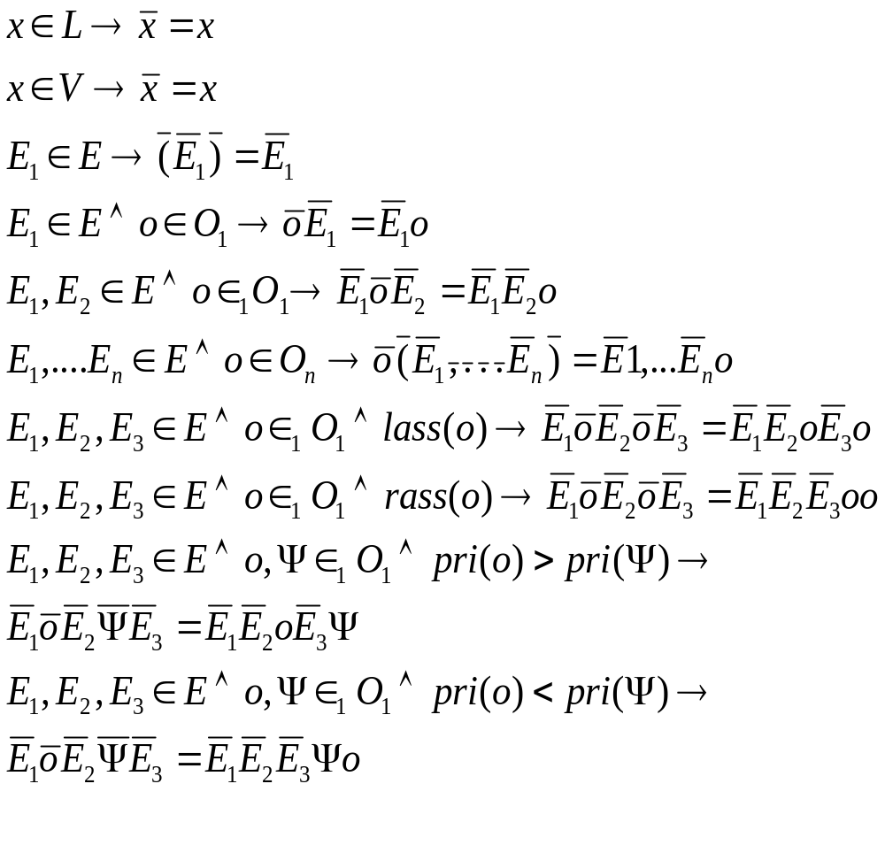
Maths version here
Notes:
<νυμβερ>
Just the maths notation of what went before – slightly extended:
1st 6 rules exactly whats expected
In the 7th rule we have a function that returns if the operator o is left associative
In the 8th rule we have a function that returns if the operator o is right associative
The last rule on the previous informal specification is broken into 2 here: for the 2 operators, if the o has the higher priority, it stays closest to the (its) operands
If the theta has, it stays closest to its operands and pushes the o out

Slide 16
Helps translate into an Automaton For Creating RPN
Input and stack required:
  Variables are copied to output
  ‘(‘ always pushed onto stack;
  ‘)’ causes popping off stack until ‘(‘ is encountered;
  If operator with priority > current stack top:
    Push onto stack
  If operator with priority <= than current stack top:
    Pop current stack top;
    Do not advance scan pointer;
  When end of input, pop the remainder of the stack
Notes:
<νυμβερ>
With these rules, it shouldn’t be that hard to make an automaton for creating RPN (a good idea seeing as we have so much difficulty writing RPN). Dijkstra with his shunting-yard algorithm.
Actually became the basis for one of HPs best selling calculators. Type in numbers and then operation happens as you type in operators
Try: b*b-4*a*c
Let them try (4+5)*(8-3) // assume brackets have lowest priority

Slide 17
To Summarize, to date
Appreciation of structuring of (complex) maths expressions;
Proofs: generating new truths/language instances;
Adapted to schema, to generate strings-with-properties language instances:
  Post Production Systems;
And schema to generate general (maths) language instances:
  Valid expressions;
In doing so, we have seen how rules can be used in generation of language instances;

Slide 18
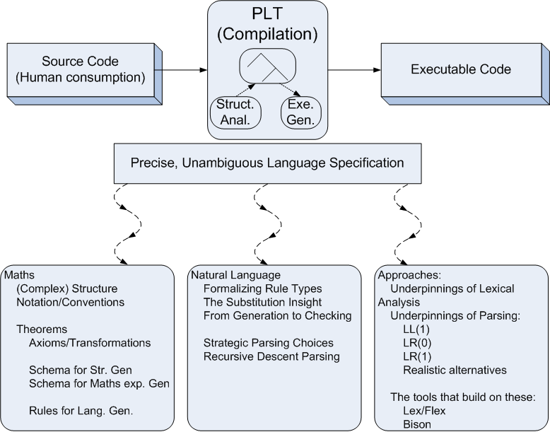

Module Overview

Slide 19
Chomsky’s First Two Contributions
He focused on the study of languages, rather than Maths
  At above word level, rather than strings
He realised that (abstraction-based) substitution could be used instead of Post’s extension/transformation:
  English structures could be generated by populating a template of categories:
    Phrase:
      The brown cat, A brown dog
      What are the abstractions?

Slide 20
Phrase Structure (in production-rule format)
Instances:
    The big rat
    A helpful frog
    Some brown cat
Productions
    A->some, A->a, A->the
    D->big, D->brown, D->helpful
    N->cat, N->rat, N->frog
    P->ADN
    Where {some, a the, big, brown, helpful, cat, rat, frog} are the Literals
    And {A, D, N, P} are the Variables
Notes:
<νυμβερ>
How can we accommodate all the above instances
Here are the production rules – variables and literals obvious. Most of the production rules already there, just a new one to take care of sentences being noun-phrase, verb, noun-phrase
I do one, they do 2 and 3. Use the overbrace, with LHS on top notation

Slide 21
Try: How do we cope with 1 or more adjectives
    For example:
      The big brown rat
      The big brown helpful cat
    This is vitally important:
      Covers lots of cases in programming languages;
      2 examples:
    And how do you cope with 0, 1 or more

Slide 22
How do we cope with 1 or more adjectives
    For example:
      The big brown rat
      The big brown helpful cat
Productions
    A->some, A->a, A->the
    D->big, D->brown, D->helpful
    N->cat, N->rat, N->frog
    P->AQN
    Q->D
    Q->DQ

Slide 23
How do we cope with 0, 1 or more adjectives
    For example:
      A frog
      The big brown rat
      The big brown helpful cat
Productions
    A->some, A->a, A->the
    D->big, D->brown, D->helpful
    N->cat, N->rat, N->frog
    P->AN
    P->AQN
    Q->D
    Q->DQ
Notes:
Q-> D is now redundant, making the grammar ambiguous:
Q->DQ where Q goes to lamba, would have the same effect: therefore 2 parse trees, therefore ambiguity
<νυμβερ>

Slide 24
Try: An Overall Sentence Structure
Instances:
    The cat chased the big rat
    The big dog hit the black helpful frog
    A frog caught a big black helpful cat
Notes:
<νυμβερ>
How can we accommodate all the above instances
Here are the production rules – variables and literals obvious. Most of the production rules already there, just a new one to take care of sentences being noun-phrase, verb, noun-phrase
I do one, they do 2 and 3. Use the overbrace, with LHS on top notation

Slide 25
Overall Sentence Structure
Instances:
    The cat chased the big rat
    The big dog hit the big helpful frog
    A frog caught a big black helpful cat
Productions
    A->some, A->a, A->the
    D->big, D->black, D->helpful
    N->cat, N->rat, N->dog, N->frog
    V-> hit, V->chased, V->caught
    S-> PVP
    P->AN
    P->AQN
    Q->D
    Q->DQ
Notes:
<νυμβερ>
How can we accommodate all the above instances
Here are the production rules – variables and literals obvious. Most of the production rules already there, just a new one to take care of sentences being noun-phrase, verb, noun-phrase
I do one, they do 2 and 3. Use the overbrace, with LHS on top notation

Slide 26
Stop Here

